Slide 1
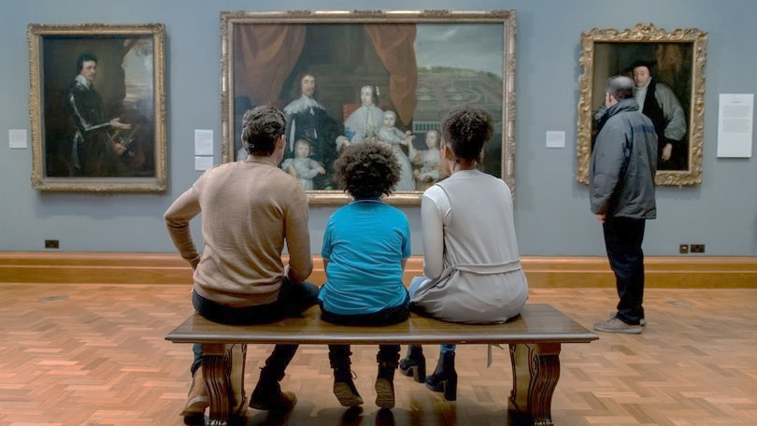
Extraordinary Donor Experiences

Slide 2
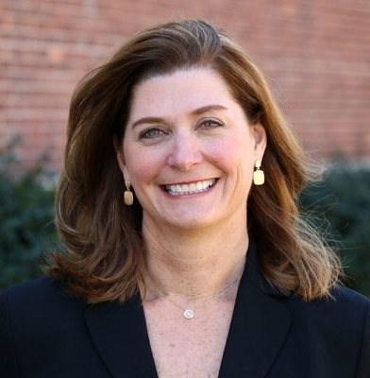
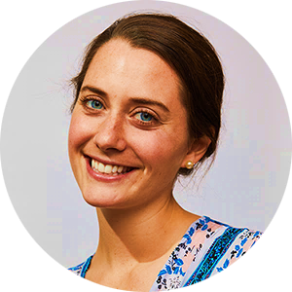
TODAY’S PRESENTERS
Dawn Fleming, CFRE
Director of Donor Relations
and Planned Giving
Holy Family Passionist Retreat Center
Margaret Fleming, MA
Corporate Marketing Manager
CCS Fundraising

Slide 3

WHO IS WHO IN THE ROOM?

Slide 4

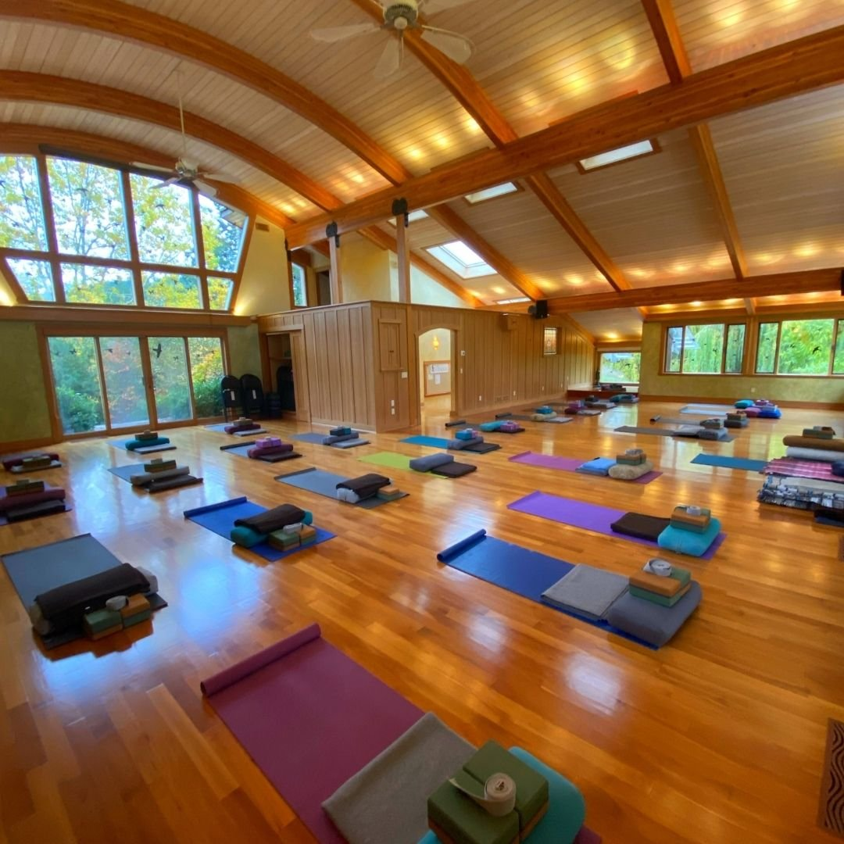
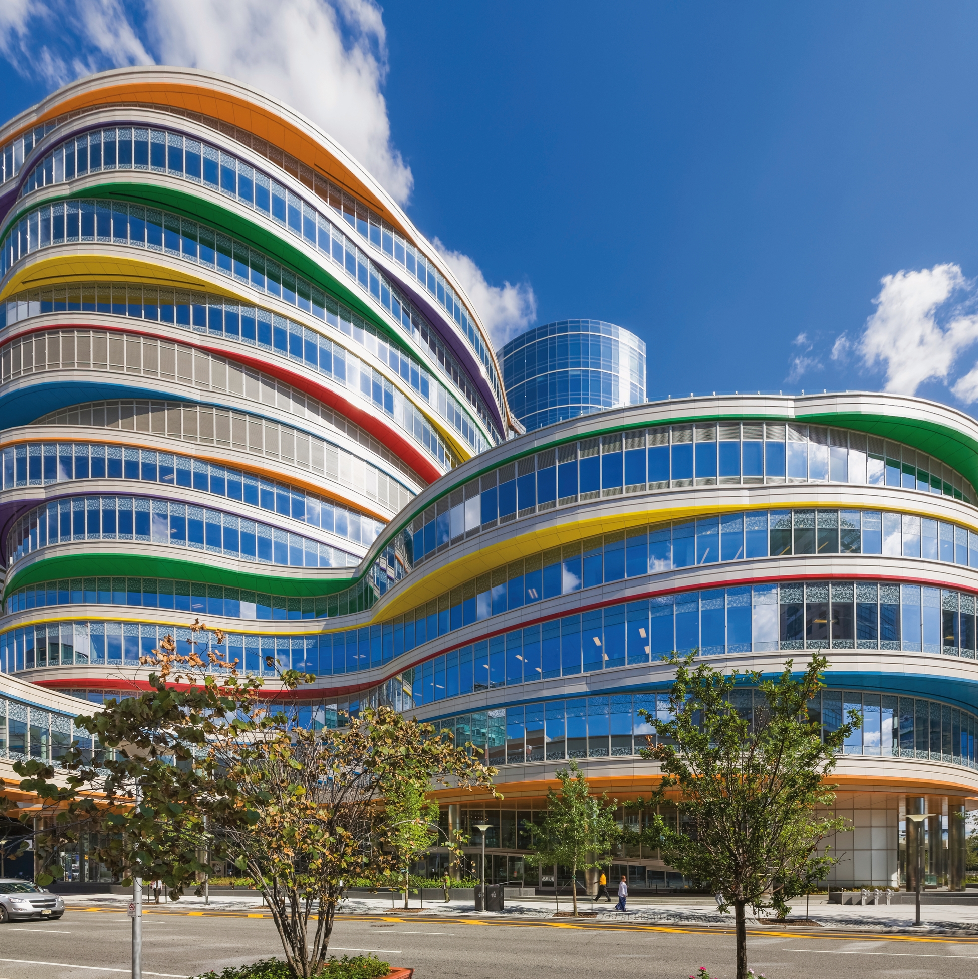

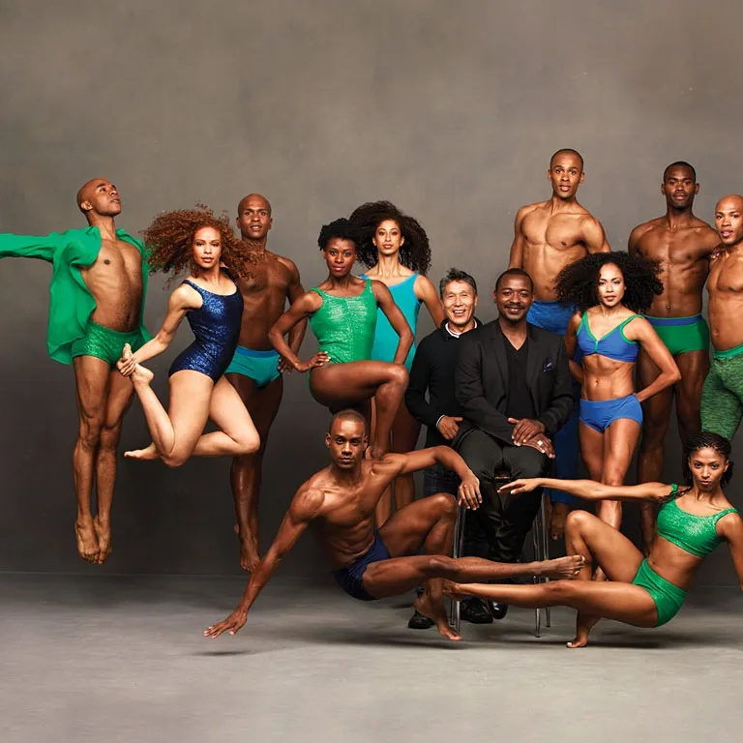
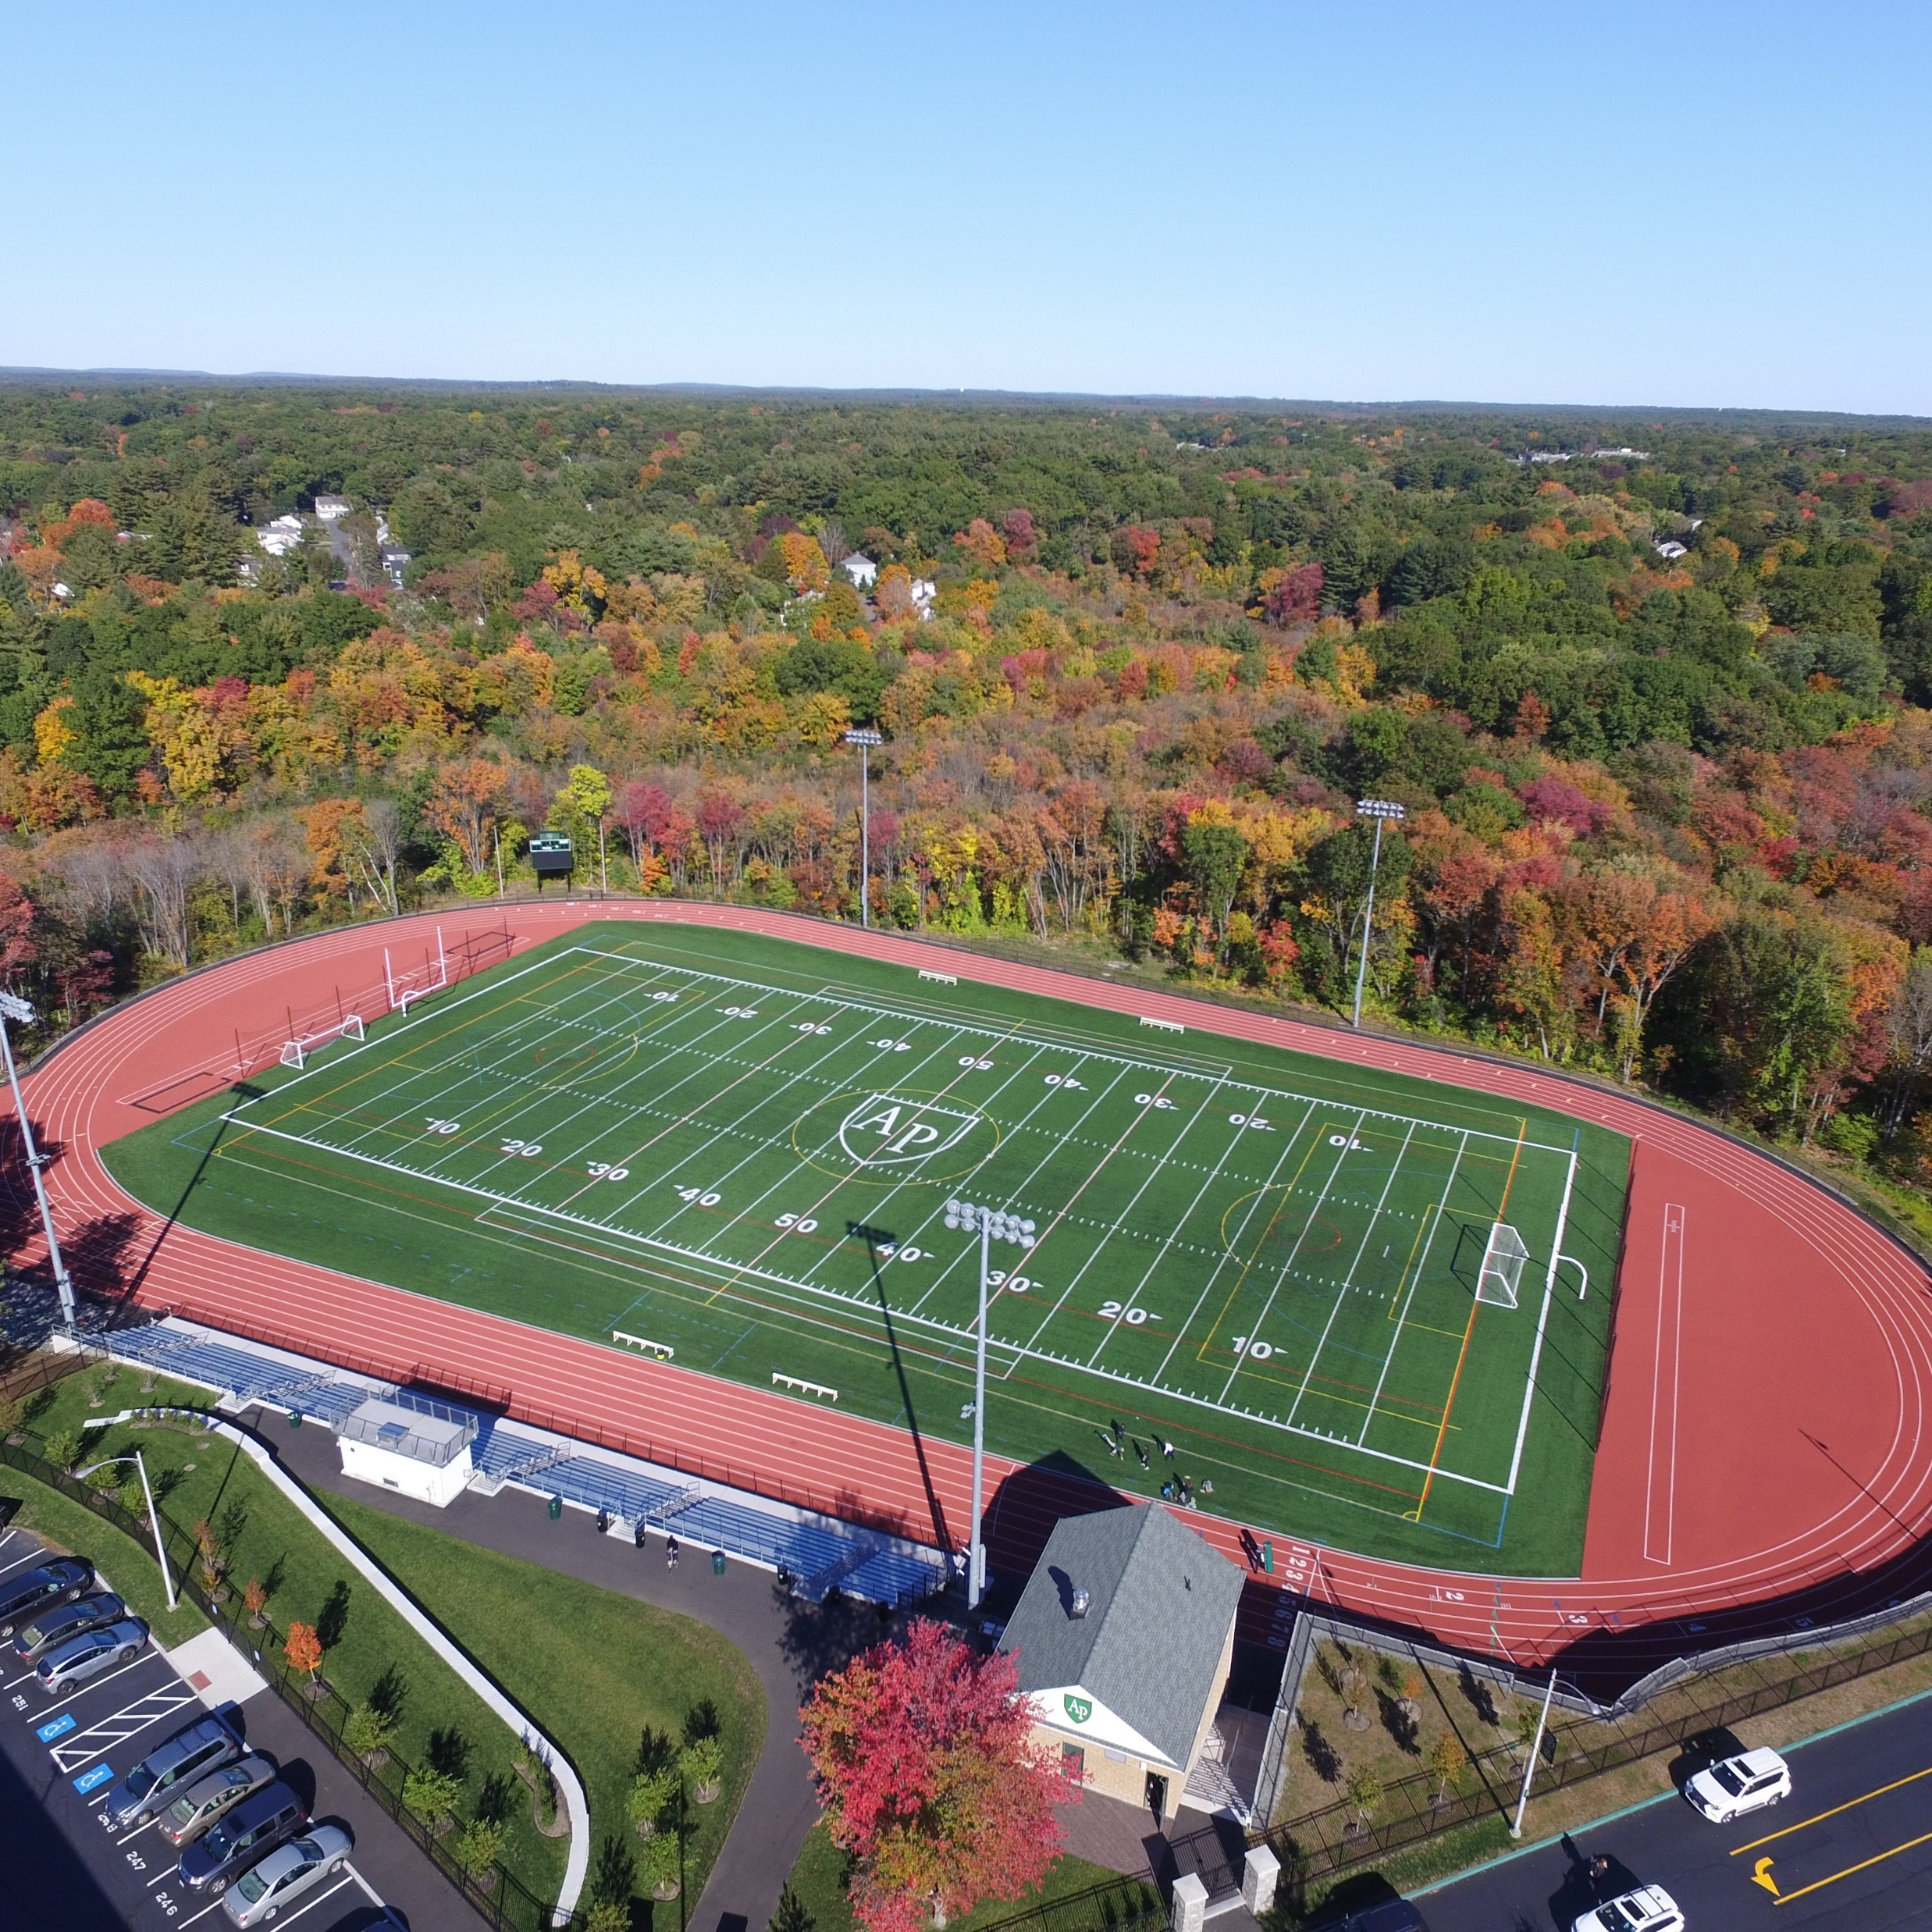
THANK YOU

Slide 5
Overview of today’s conversation
What are Extraordinary Donor Experiences (EDEs)?
Why is it critical that you continuously work within the EDE framework?
How do EDEs inform your conversations and fundraising strategies?
What does psychology say about the brain and EDEs?
What EDE best practices can you implement now as you head into the year-end fundraising season?

Slide 6



EDEs HONOR THE DONOR AND CREATE THE CONDITIONS FOR JOYFUL GIVING

Slide 7


EDEs LAY THE GROUNDWORK FOR TRANSFORMATIONAL GIFTS
Treat all donors with the utmost care and respect
Uncover their deepest passion through deep listening
Ultimately, transformational gifts are made that delight donors and meet organizational needs

Slide 8

5 COMPONENTS OF
EXTRAORDINARY DONOR EXPERIENCES
REMEMBER CACTUS
C
A
C
T
S
CENTER ON THE DONOR
ALWAYS AUTHENTIC
CHOICE AND PERMISSION
THANK AND REPORT BACK
SINCERITY AND EMOTION

Slide 9

CENTER ON THE DONOR
9
THE “ME” CONVERSATION GETS OLD FAST!

Slide 10
Center on the Donor
Conversations that focus on how wonderful your organization is get old, FAST.
Start conversations with a beautiful question and you will have a beautiful conversations.
As fundraisers, we need to go deeper to the very hearts of our donors to the place where we find out what resonates with them.
Formulate questions that invite honesty, dignity, and revelation. Spend some time formulating and asking better questions and watch what takes place!

Slide 11
CENTER ON THE DONOR
Deliver what they want
or need
or crave

Slide 12



3 Rules of Authenticity
Always be authentic; your donors will know the difference
Own your mistakes or those of your organization
Affirm your donor’s values, even when they say “no”

Slide 13
"I've learned that people will forget what you said, people will forget what you did, but people will never forget how you made them feel." -Maya Angelou

Slide 14
What to say when your organization DOESN’T do what they promised to do with your donor’s gift...

Slide 15

ALWAYS AUTHENTIC
Real-life example of five-figure ask hanging in the balance
  From: Liz
  Sent: May 25, 2022
  To: Dawn Fleming
  Subject: Thank you, Liz!
  Dawn,
  Thanks for the reach out. I have been giving it thought and haven’t come to a settling point myself.
  To be honest I am absolutely heart sick over the school shooting in Texas. . . for some reason I am partially stuck on whether the Catholic Church will stand up for gun control . . . I need to settle on this for a bit . . .So Dawn, I just need more time.
Donor expresses philanthropic priorities in reaction to tragedy

Slide 16
ALWAYS AUTHENTIC
Real-life example of five-figure ask hanging in the balance
  From: Dawn Fleming
  Sent: May 26, 2022
  To: Liz
  Subject: Thank you, Liz!
  I hear you. When Sandy Hook happened (we live in the neighboring town) I sobbed like a baby. . . I’m not sure whether the Catholic Church will stand up for gun control. And you are right, why not use the power of Jesus’ teachings for a critical cause? It’s clear as day to all of us here.
  As we move through these troubling times, I am focusing on how, in a sense, places like Holy Family are an endangered species. These places are unique, sacred, and excruciatingly important to each of us in today’s world. That’s what keeps me going and why I can advocate for HF. People leave here better, and the ripple effect is strong. That’s not a sales pitch, just a chance to share what I observe and why I can fight hard for HF.
Fundraiser responds with authenticity and reflects donor’s values

Slide 17
ALWAYS AUTHENTIC
Real-life example of five-figure ask hanging in the balance
  From: Liz
  Sent: May 26, 2022
  To: Dawn Fleming
  Subject: Thank you, Liz!
  You are so wonderful, and I appreciate your support. I am so down and just feel so helpless. I want to figure out how to make a difference.
  Your email only confirms why HF is so special....because they have people like you there.
  Will be back to you, I promise.
  Liz
Donor is reminded why organization is a priority

Slide 18
CHOICE AND PERMISSION
Choice
Permission
Offer a donor and ensure their
GATHER 2-3 DONATION OPTIONS TO PRESENT
DISCUSS ALIGNMENT WITH DONOR’S PRIORITIES
ENSURE DONOR IS IN CONTROL OF THE GIFT DETAILS
REQUEST MEETING TIME WITH DONOR
OFFER TAILORABILITY BASED ON DONOR PRIORITIES

Slide 19
Choice and Permission
CHOICE
Do you have 30 minutes or so on date 1, 2, or 3 to visit in person?
I’m happy to drop by your home or office, meet you for lunch, or just grab coffee. Whatever works best for you, <NAME>.
I’d love to share an update about how your support helped us ______ and ask for your support this year with ________. Is this something you might like to discuss?
I’d love to visit and share our vision. I won’t be asking for anything from you . . .

Slide 20
Choice and Permission
PERMISSION
Ask for permission to schedule a personal visit . . .
  Setting up the visit:
If I may, can I ask you about . . . . ? Or “would you like to” . . .
Can you tell me more about . . .
Are you comfortable sharing . . .
“Would it be okay if we talked about ____ on our next visit?”

Slide 21
THANK – 3 P’s
PROMPT
The perfect
“thank you!”
Aim to send thanks within 48 hours of donor interaction
PROFUSE
PERSONAL
Know why your donors were generous and reflect that right back to them.
Gush with gratitude and Emphasize their impact

Slide 22
EXAMPLE “THANK YOU” LANGUAGE
Your gift arrived today and with it came great joy as it goes to work right away to provide lifesaving surgery for premature babies in the remote areas of . . .
Because of wonderful people
like you . . .
You may not realize it, but your gift provided the only . . . .
Your loyal support makes it possible for . . .

Slide 23


THANK YOU: THE VIRTUOUS CYCLE
She feels great, trusts your organization, and is likely to give again
ASK
She gives a gift and feels great
REPORT
But she doesn’t know what’s going to happen
Sees how her gift made a difference
But she still doesn’t know if her gift made a difference
THANK
She knows the give was received and appreciated
Source: The Better Fundraising Company

Slide 24
Thank you for safeguarding our future . . .
In a world full of uncertainty you gave protection, hope, and new life to Holy Family.
Through your support of our Resilience Fund, you reached into your heart to save this sacred place and to serve those who yearn for God and the transcendent in our world.
And what a mighty gift that has been to all who turned to Holy Family for spiritual nourishment over these many months.
It is precisely because we are weary, and poor in spirit, that God can touch us with hope.
And it is precisely because of your generosity that we can facilitate God’s work right here at Holy Family.
As we celebrate your generosity, we hope you will sense the magnitude of what it means to pour your gifts into lives and to have them changed by the ministries you support.
We are in awe of your kindness.
EXAMPLE

Slide 25
GRATITUDE REPORT –
THE PROBLEM
I eloped at 17 to marry my high school sweetheart. We were on top of the world. But sometimes life doesn’t go as planned.
In a few short years, we had seven children and a whole host of challenges.
By the time I was 35, I was working long hours, drinking heavily, and getting involved with other women. My life was spinning out of control.
My wife was at her wits’ end and asked me to move out. At 35 years old, I moved in with my mother.
My mother thought the best way for me to get my life back on track was to spend some time on retreat at Holy Family. So she gave me $65 (which was a large sum for her back then) and sent me away for the weekend.
That was back in 1975.
Articulate the problem that your organization is trying to solve.

Slide 26
GRATITUDE REPORT –
DONOR VALUES
On retreat, I encountered a young Passionist priest, Fr. Vince, who preached a message of forgiveness and God’s invitation to wholeness.
Fr. Vince encouraged me to identify one big thing that I was terribly sorry for. I spent a lot of time with that question. I wept a lot.
Then, it was like a bolt of lightning seared my consciousness. The word ‘selfish’ came to mind, along with a whole lot of regret.
This was the first big step on my spiritual journey and my life of recovery.
On retreat in 1984, Holy Family even helped me hear God’s call to change my career and become a counselor. I still counsel adopted children to this day.
Center on donor values.

Slide 27
GRATITUDE REPORT –
PROBLEM SOLVED
I went back to work, but I was a different man — something had shifted inside me. I felt God’s presence and looked for ways to align my life with God’s intention for me.
I sought counseling and was eventually invited to return home for a “trial run.” My wife and I began having honest conversations for the first time ever, really.
And although our marriage had strong wounds, we worked hard to find opportunities to heal.
Holy Family saved my marriage and gave me my family back. It’s extraordinary what can happen when the door is open, and God’s work can begin.
And that’s just what happens to me when I’m at Holy Family — I get the message I need to from God.
Demonstrate how your organization helped solve the problem… in the beneficiary’s own words.

Slide 28
GRATITUDE REPORT –
DONOR REWARD
My life is completely different because of Holy Family. Today, I support others in addiction, counsel children, and share my story of redemption openly with others.
I’ve been attending retreats at Holy Family every year for forty-seven years, and I invite friends to “Come Away and Rest Awhile” with me.
If they can’t pay, I will pay for them, just like my mom did for me.
I enjoy an extraordinary spiritual life. I participate in prayer in all forms. I pray with my family at home and with those struggling with addiction.
My story is not unique.
I am sure there are others whose lives are engulfed in self- destructive behaviors even as I share my story with you.
I am so grateful that Holy Family continues to invite everyone who wishes to spend time with God and to get to know the person they were born to be.
Holy Family truly transforms lives, mends broken hearts, and restores relationships. I am living proof of that.
~ Jim
Demonstrate how the donor’s investment makes a difference.

Slide 29






SINCERITY AND EMOTION
Validate the donor’s priorities
Ask open-ended questions
WHY CAMPAIGN?
Paraphrase and reflect back what you heard
Sincere
engagement is the key!
Don’t pass judgement on the donor’s personal wishes
Give it time before requesting philanthropic support
Clarify what their goals are with offering options

Slide 30




PSYCHOLOGY OF AN EDE
Sense of group belonging
Opportunity for trusting relationships
Greater stability to express values in an uncertain world
Altruistic behavior creates pleasant connections

Slide 31



Employing EDEs at Year-End
You’ve met with donors, centered on them, been authentic. offered choices, thanked and reported back with sincere gratitude.
It’s time to reap the benefits!
Come into the giving season strong by asking any donor who has not made a major gift within the last 3-6 months to consider making a gift before year-end.

Slide 32

REMEMBER THIS SLIDE?
HOW DID IT MAKE YOU FEEL?

Slide 33

WHAT WE COVERED
Center on the Donor
C
Always Authentic
EXTRAORDINARY
DONOR
EXPERIENCES
A
Choice and Permission
C
Thank and Report
T
Sincerity and Emotion
S

Slide 34
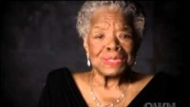
YOU DO GOOD!
34
A MESSAGE FROM MAYA ANGELOU

Slide 35
THANK YOU!

Slide 36
QUESTIONS?

